Slide 1

EE 252
Electrical Engineering Machines
UNIT 4 – Transformers
E.O.K. Addo
hodaddo79@yahoo.com//0248810587

Slide 2
Unit 4 – Outline of Presentation
Introduction
Principles of operation of transformers
Basic relationships of transformer parameters
Operation of transformer under “no-load” and “load” conditions
Voltage and current transformation ratios
Equivalent circuit diagrams of transformers
Voltage regulation
Transformer losses
Test performed on transformers
Efficiency of transformers
Cooling of transformers and cooling designations

Slide 3
4.1: Introduction
A transformer is a stationery AC voltage-changing device by means of which electrical energy in one circuit is transformed or transferred to electrical energy in another circuit, and at the same frequency .
The transformation may involve either the stepping up (step-up transformer) or stepping down (step-down transformer) of the supply voltage.
Power is usually generated at low or medium voltages (13.8 kV at VRA), and stepped up at the generator station (to 161 kV by VRA) before being transmitted at high voltage along lines over long distances to load centers or regions of consumption.
The two main aims of transmitting the power at a higher voltage are to (i) reduce losses and (ii) reduce voltage drops.

Slide 4
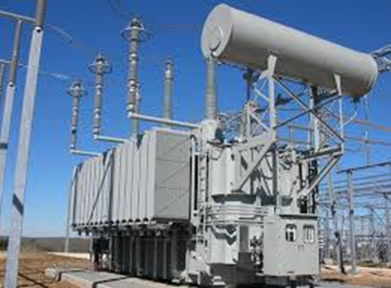
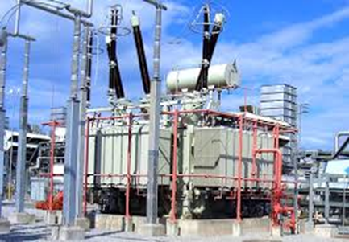
4.1: Introduction (2)
Transformers have no moving parts, and are simple, rugged, and durable in construction, thus requiring little attention.
They also have a very high efficiency (can be as high as 99%).
As a static electric device, it consists of a winding, or two or more coupled windings, with or without a magnetic core.
It transfers power by electromagnetic induction between the circuits at the same frequency, but usually at changed values of voltage and current (either serving as step-up or step-down function).

Slide 5
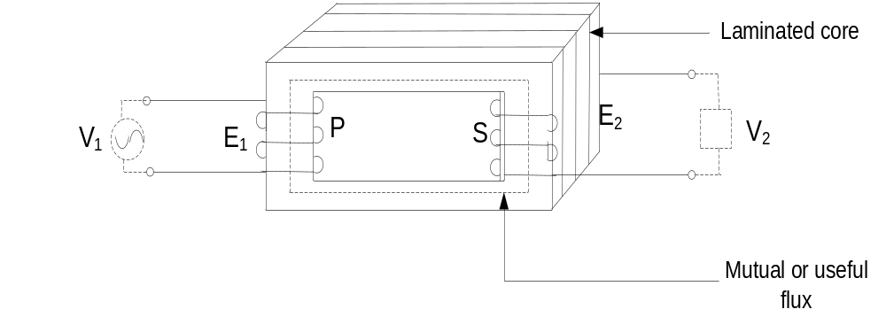
4.2: Principle of operation of transformer
The transformer is an application of Faraday’s Law of Electromagnetic Induction and Lenz’s Law.
A single-phase two-winding transformer is the simplest form of the two-winding transformer consists of two coils of wire, the primary windings (P) and secondary windings (S) insulated from each other and wound on a common laminated iron core.
The core may take one of many forms, such as a toroid or a rectangular frame

Slide 6
4.2: Principle of operation of transformer (2)
The coils are connected to an external circuit.
The primary winding is connected to an electrical source, an AC supply whose voltage or current varies with time.
From Faraday's observation,
  the alternating primary current which flows in the primary windings generates an alternating magnetic flux, known as useful or mutual flux
  The useful flux links or cuts not only the primary windings but also the secondary windings
  The generated flux linkage induces an alternating emf in the secondary windings.
Because the secondary coil is in circuit, it will also carry a time-varying current, the secondary current.
This secondary current will also contribute to the magnetic field, so that the total magnetic field is created by contributions from both currents.

Slide 7
4.2: Principle of operation of transformer (3)
The coils are connected to an external circuit.
The primary winding is connected to an electrical source, an AC supply whose voltage or current varies with time.
From Faraday's observation,
  the alternating primary current which flows in the primary windings generates an alternating magnetic flux, known as useful or mutual flux
  The useful flux links or cuts not only the primary windings but also the secondary windings
  The generated flux linkage induces an alternating emf in the secondary windings.
Because the secondary coil is in circuit, it will also carry a time-varying current, the secondary current.
This secondary current will also contribute to the magnetic field, so that the total magnetic field is created by contributions from both currents.

Slide 8




4.3: Basic relationships of transformer parameters
In considering the basic theory, few assumptions are made
  Firstly, if the applied or source voltage to the primary windings is sinusoidal, it is assumed that the emf induced in the secondary windings is also sinusoidal.
  Secondly, we will also assume that all the flux generated by each current links both primary and secondary coils - that is, the flux linking each coil is the same, so that there is no flux leakage.
Let
= number of turns on the primary
= number of turns on the secondary
= maximum value of the flux linking (Wb)
Since the flux is assumed to vary sinusoidally, the flux at any instant is

Slide 9
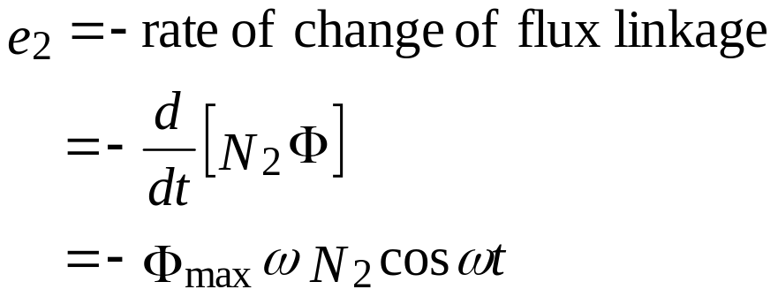
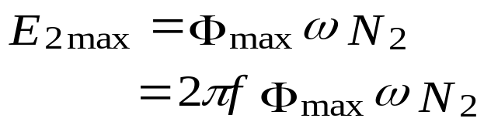
4.3: Basic relationships of transformer parameters (2)
Hence, applying Faraday’s Law of electromagnetic induction and Lenz’s Law, the instantaneous electromotive force (emf) induced in the secondary coil of turns linked by this flux is given by:
The minus sign indicates that the instantaneous induced emf acts in a way to oppose the flux inducing it (Lenz’s Law).
Neglecting the sign, the maximum value of the induced emf is:

Slide 10
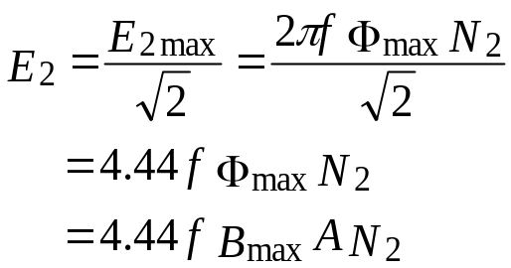
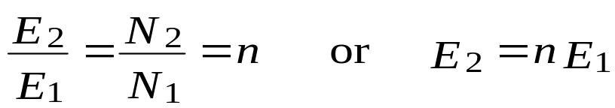
4.3: Basic relationships of transformer parameters (3)
The r.m.s. value of the secondary voltage can be obtained from the maximum value as:
Similarly, at the primary side, the voltage is
Combining the equations, we obtain the ratio:
This is called the voltage transformation or turns ratio, n.
The emf transformation ratio is equal to the turns ratio.
Depending upon the turns ratio, the transformer can either step-up (n>1) or step-down (n<1) voltage.

Slide 11
4.4: Operation of transformer under “no-load” conditions
A transformer is said to be operated on "no-load" when the secondary winding is open-circuited.
Under no-load, the primary will act like a highly inductive circuit, and its flux contribution comes only from the no-load current from the supply voltage.
This flux is referred to as the no-load flux, or the useful flux.
The no-load flux is responsible for:
  voltage inductions in both the primary and secondary windings
  magnetization and subsequent losses of the core

Slide 12







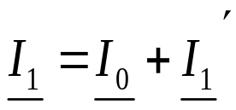
4.5: Operation of transformer under “load” conditions
When a load is connected to the secondary side, a current flows due to the induced voltage ,and sets up a secondary mmf .
This secondary mmf produces a secondary flux that has the same magnetic path as and in the opposite direction to the useful flux originally set up in the primary due to the no-load current, and links with the primary winding.
The load (secondary) current causes the primary to take more current in addition to the no-load current , such that:
The total primary current is phasor sum of the no-load current and the additional current; that is:

Slide 13
4.5: Operation of transformer under “load” conditions
When a load is connected to the secondary side, a current flows due to the induced voltage ,and sets up a secondary mmf .
This secondary mmf produces a secondary flux that has the same magnetic path as and in the opposite direction to the useful flux originally set up in the primary due to the no-load current, and links with the primary winding.
The load (secondary) current causes the primary to take more current in addition to the no-load current , such that:
The total primary current is phasor sum of the no-load current and the additional current; that is:

Slide 14
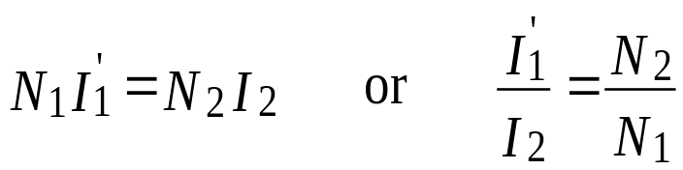
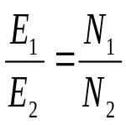
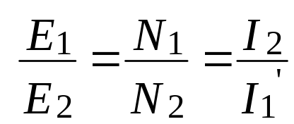
4.5: Operation of transformer under “load” conditions (2)
From the equality of the two primary and secondary mmfs, we have
Comparing with the voltage transformation equation , we obtain the relationship
The current transformation ratio is seen to be the inverse of the voltage transformation ratio.

Slide 15
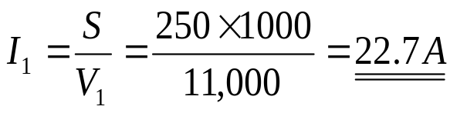
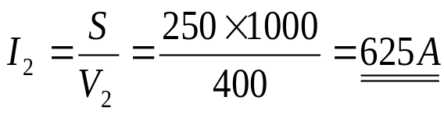
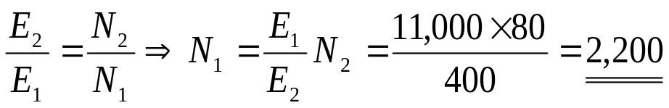
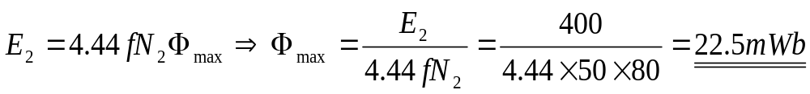
Example 4.1 & Solution 4.1
A 250 kVA 11,000 V/400 V 50 Hz single-phase transformer has 80 turns on the secondary side. Calculate the following:
  approx. values of the primary and secondary currents
  approx. number of primary turns
  maximum value of the flux
SOLUTION
a)The full-load primary and secondary currents are
b) The number of primary turns is found from the
c)The maximum flux is found as:

Slide 16
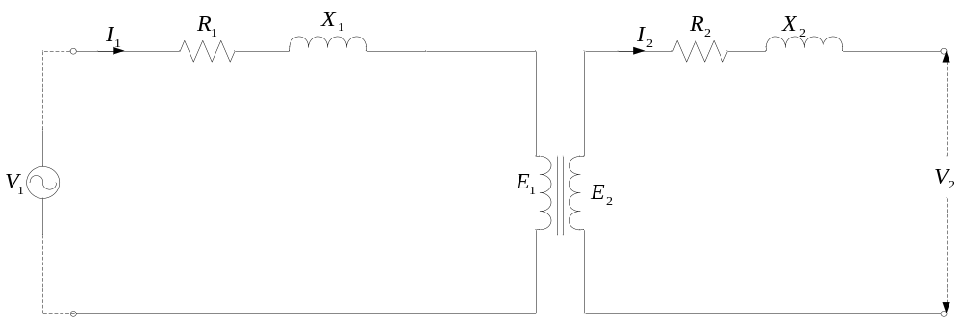
4.6: Equivalent circuit diagrams of transformer
In an actual transformer, the windings will have resistance and inductance or reactance
A model of the physical transformer should include winding resistance and reactance
The equivalent circuit diagram of a low-frequency transformer is
Fig 4.1: Equivalent Circuit Diagram of Transformer

Slide 17








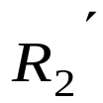

4.6: Equivalent circuit diagrams of transformer (2)
and are the resistances of the primary and secondary windings respectively.
and are the reactance due to the leakage fluxes in the primary and secondary respective windings
and are the full-load (rated) currents flowing in the primary and secondary windings respectively
To simplify calculations, the resistance and of the secondary windings can be referred to the primary to obtain and .
The simplified approximate equivalent circuit is as shown in the figure below

Slide 18
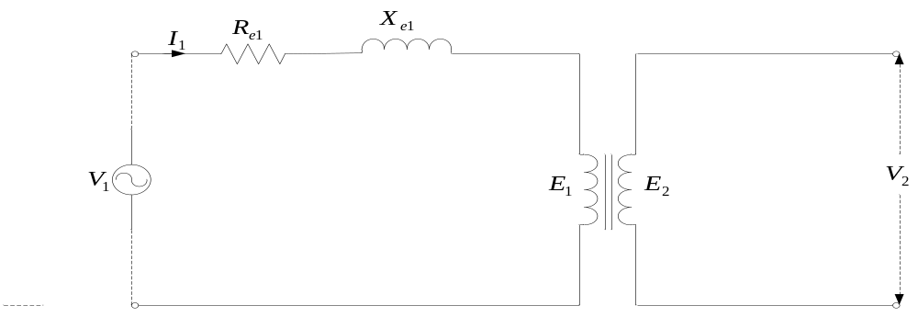
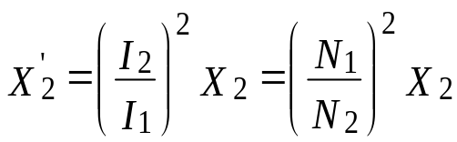
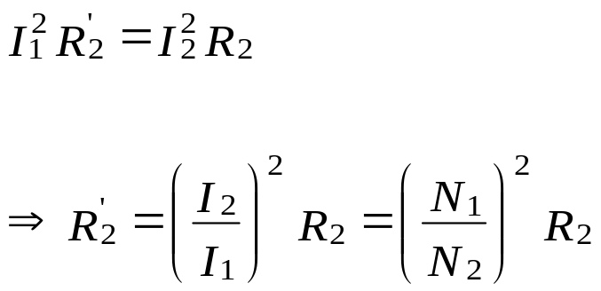
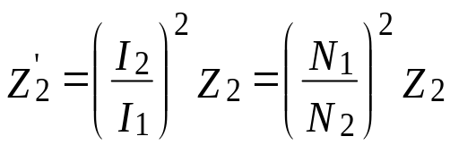
4.6: Equivalent circuit diagrams of transformer (3)
Fig 4.2: Simplified Equivalent Circuit Diagram of Transformer
In referring to the primary, we assume that the losses are the same.
Thus ; Also

Slide 19
4.6: Equivalent circuit diagrams of transformer (3)
Fig 4.2: Simplified Equivalent Circuit Diagram of Transformer
In referring to the primary, we assume that the losses are the same.
Thus ; Also

Slide 20
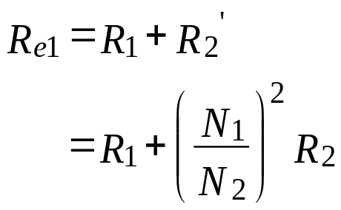
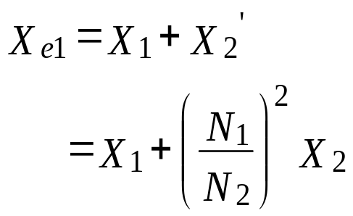
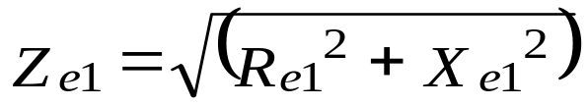
4.6: Equivalent circuit diagrams of transformer (4)
The total equivalent resistances and reactances when referred to the primary are given by:
The equivalent impedance, when referred to the primary, is

Slide 21
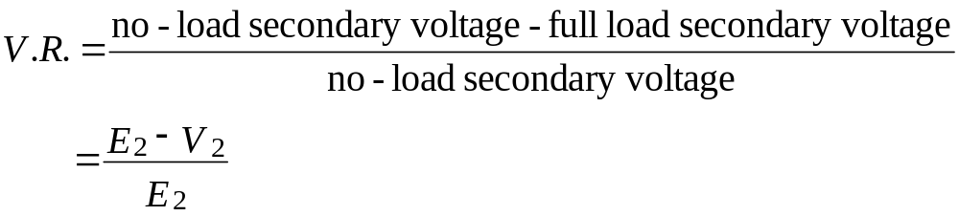

4.7: Voltage Regulation
By voltage regulation, we are referring to measures to ensure that voltage variation at the secondary terminals is reduced to practically acceptable limit
The voltage regulation (VR) is defined as the change in secondary terminal voltage expressed as a percentage (or p.u.) of the secondary rated voltage under no-load conditions:
Mathematically, the voltage regulation can be expressed as:
Subsequently, the secondary terminal voltage is given as:

Slide 22

4.7: Voltage Regulation (2)
In terms of the referred quantities, the voltage regulation can be expressed generally as:
+ sign: lagging power factor
-sign: leading power factor
Accordingly, depending upon the lag or lead of the p.f., the secondary full-load terminal voltage is given by

Slide 23
Example 4.2
A 100 kVA transformer has 400 turns on the primary and 80 turns on the secondary. The primary and secondary resistances are 0.3 Ω and 0.01 Ω respectively, and the corresponding leakage reactances are 1.1 Ω and 0.035 Ω respectively. The supply voltage is 2,200 V.
Calculate the following:
  Equivalent impedance referred to the primary circuit
  Voltage regulation and the secondary terminal voltage for full-load having power factor of
(i) 0.8 lagging (ii) 0.8 leading

Slide 24
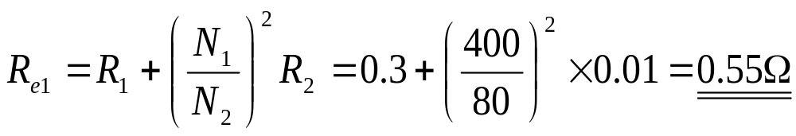
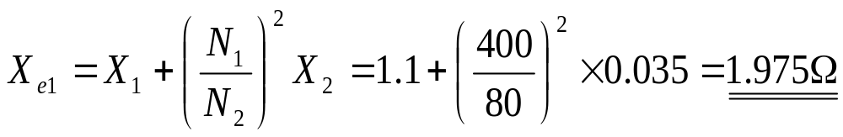
Solution 4.2
(a) The equivalent resistance referred to the primary side is
The equivalent leakage reactance referred to the primary side is
The equivalent impedance referred to the primary side is

Slide 25


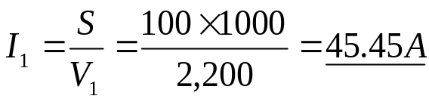
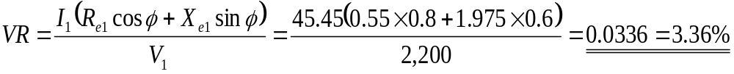
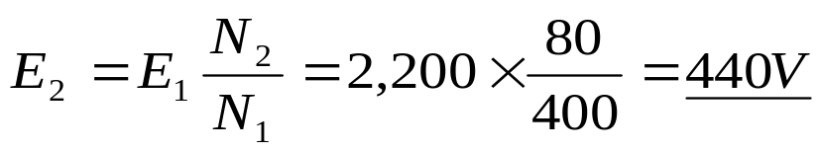
Solution 4.2 (2)
(b)(i) Since , then
Full-load primary current is
Hence the voltage regulation for a power factor of 0.8 lagging is
Secondary terminal voltage on no-load is equal to the induced emf , and is
Thus the secondary terminal voltage on lagging full-load is given as

Slide 26

Solution 4.2 (3)
(b)(ii)
The voltage regulation for a power factor of 0.8 leading is
Secondary terminal voltage on no-load is equal to the induced emf , and is
Thus the secondary terminal voltage on leading full-load is given as

Slide 27
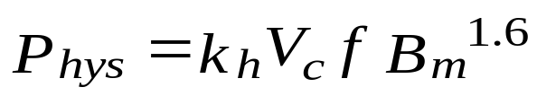
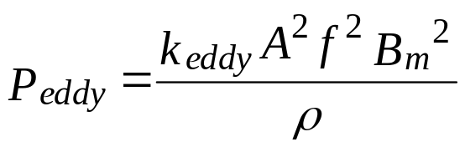
4.8: Transformer Losses
The losses in the transformer could be generally classified into two.
These losses are (1)core or iron losses and (2)copper losses.
IRON LOSSES
The iron losses also consist of (i) hysteresis losses and (ii) eddy-current losses in the core of the transformer.
Hysteresis Losses – are obtained by Steinmetz formula:
The eddy-current losses – can be obtained from the equation

Slide 28
4.9: Tests Performed on the Transformer
Two main tests performed on the transformer are the Open-Circuit (No-Load)Test and Short-Circuit Test.
These tests are performed to determine the following:
  voltage regulation (VR),
  the efficiency η and
  other equivalent circuit parameters of the transformer without actually loading it.
The power required during these two tests is approximately equal to the appropriate total power loss occurring in the transformer.

Slide 29
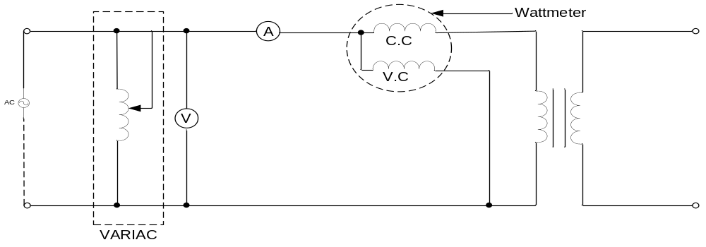
4.9.1: Open-Circuit Tests on Transformer
The secondary is left open and a rated or full-load voltage is applied through a VARIAC to the primary of the transformer.
The ammeter measures the no-load current in the primary, which is about 2.5 % the rated or full-load current.
The voltmeter measures the rated or full-load voltage
The wattmeter measures the O/C power, the equivalent of core losses

Slide 30
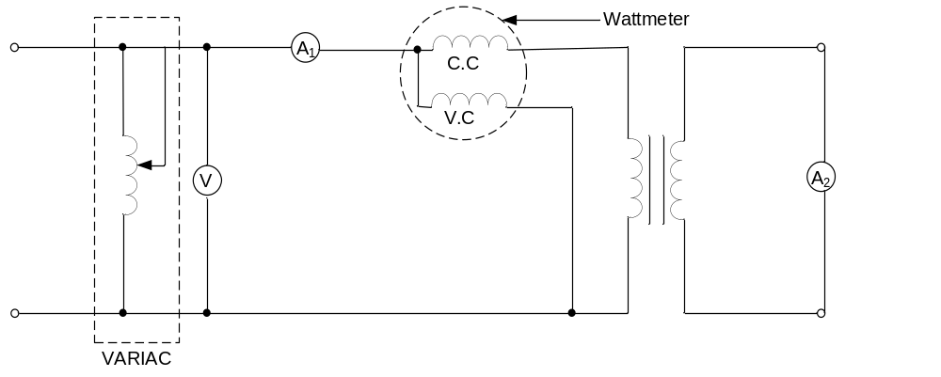
4.9.2: Short-Circuit Tests on Transformer
The secondary of the transformer is shorted through an ammeter;
A reduced voltage is applied through a VARIAC to the primary of the transformer until the rated or full-load current flows in the primary;
The voltmeter measures the short-circuit voltage;
The wattmeter measures the S/C power, the equivalent of copper losses

Slide 31
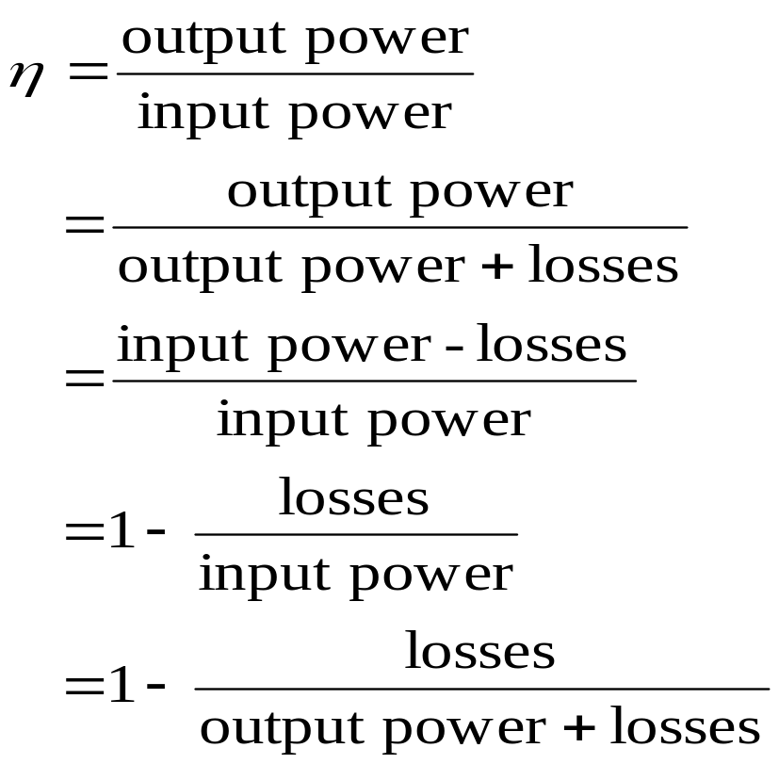
4.10: Efficiency of the Transformer
The ordinary efficiency of the transformer is given by

Slide 32
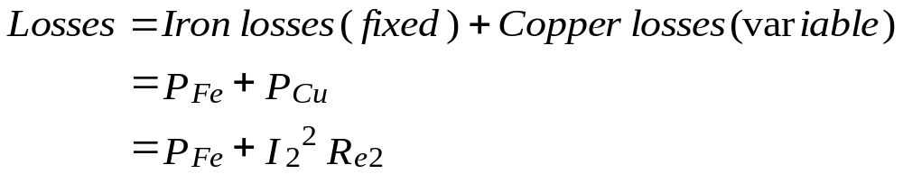
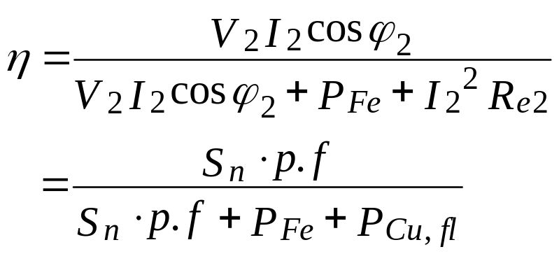
4.10: Efficiency of the Transformer (2)
Therefore the efficiency can be deduced as

Slide 33
Example 4.3
The following results were obtained on a 50 kVA transformer:
O/C test: primary voltage 3300 V, secondary voltage, 415 V, primary power, 430W
S/C test: primary voltage 124 V, primary current 15.3 A, primary power 525W, secondary current, rated value.
Calculate the efficiency at full-load for 0.7 lagging p.f.

Slide 34
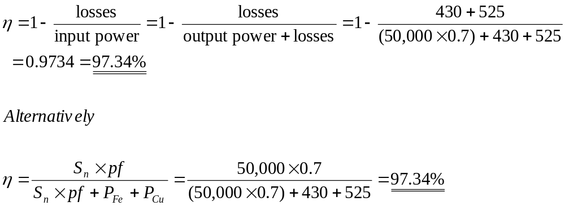
Solution 4.3
The copper losses are obtained from the S/C tests under rated conditions;
Whilst the iron losses are obtained from the O/C test.
The normal full-load efficiency load is given by

Slide 35
4.11: Cooling of Transformer
No-load losses (core losses) and load losses (copper losses) are the two significant sources of heating considered in thermal modelling of power transformers.
Cooling of transformers is done to prevent rapid deterioration of the insulating materials.
The basic method for cooling transformers is transferring heat from the core and windings to the insulating coolant such as oil.
Overheating of the transformer core can thus lead to damage.
Overheating of the windings and its attendant temperature rise can lead to accelerated ageing of the insulation and thus reduction in the life of the transformer

Slide 36
4.11: Cooling of Transformer (2)
The cooling medium air or gas is used in a dry-type transformer;
whilst mineral oil is used as cooling agent in oil-immersed transformers.
The coolant serves a dual purpose:
  transporting the heat from the winding to the places of dissipation, either to ambient air or surface of a tank
  insulating the primary from the secondary.
The small transformers rated at less than 5 kVA are generally air-cooled, that is, the heat produced is carried away by the surrounding natural air.
The oil and synthetic liquids are good insulators, unless carbonized or contaminated with moisture.
For larger transformers, the preferred cooling medium is oil, especially where high voltages are involved.

Slide 37
4.11.1: Advantages of oil over air as coolant
Oil seems to have the following advantages over air as a cooling medium:
  Oil has a larger specific heat capacity than air, so that it absorbs larger quantities of heat for the same temperature rise.
  Oil has a greater heat conductivity than air, and thus enables the heat to be transferred to the oil much more quickly.
  Oil has higher breakdown strength than air (about six times), thus offering enhanced reliability at high voltages.

Slide 38
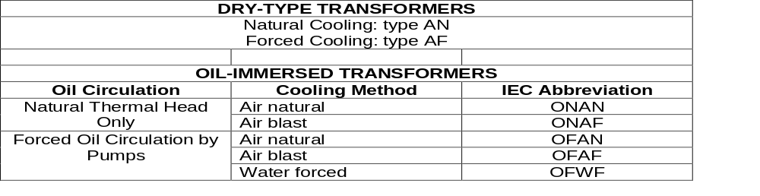
4.11.2: Cooling arrangements and designations
Both the IEEE and the IEC established standard designations for the various cooling modes of transformers.
The designation completely describes the cooling method for the transformer, and the cooling method impacts the response of the transformer insulating oil to overload conditions.
The Table below describes the various cooling designations for dry-type and oil-immersed transformers.

Slide 39
Exercises
(1) State THREE main losses in a transformer
(2) Tests performed on a 10 kVA, 200/440 V, 50 Hz, single-phase transformer yielded the following test results:
No-load test: 200 V, 1.3 A, 120 W on LV side.
Short-circuit test: 22 V, 30 A , 200 W on the HV side.
Determine the full-load efficiency for (i) 0.85 p.f. lagging (ii) 0.92 leading load.
(3) Explain the following transformer cooling methods:
  i. ONAN
  ii. ONAF
(4) Give TWO advantages of oil over air as a transformer cooling agent

Slide 40
Exercises (2)
(5) A 150 kVA transformer has 450 turns on the primary and 90 turns on the secondary. The primary and secondary resistances are 0.35 Ω and 0.025 Ω respectively, and the corresponding leakage reactances are 1.15 Ω and 0.035 Ω respectively. The supply voltage is 2,300 V. Calculate the following:
(i) Equivalent resistance and reactance referred to the primary and secondary sides
(ii) Voltage regulation for full-load having power factor of 0.75 lagging
(iii) If wattmeter readings for open-circuit and short-circuit tests performed on this transformer were respectively 1300 W and 1650 W, determine the efficiency for a 0.85 lagging power factor load.
(6) State THREE consequences of heating in a transformer.
(7) Give TWO main purposes of transformer coolant.

Slide 41

Thank You – End of Unit 4
For any concerns, please contact
elearning@knust.edu.gh
elearningknust@gmail.com
0322 191132

Slide 42
Example 4.1 & Solution 4.1
A 250 kVA 11,000 V/400 V 50 Hz single-phase transformer has 80 turns on the secondary side. Calculate the following:
  approx. values of the primary and secondary currents
  approx. number of primary turns
  maximum value of the flux
SOLUTION
a)The full-load primary and secondary currents are
b) The number of primary turns is found from the
c)The maximum flux is found as:

Slide 43
Example 4.2
A 100 kVA transformer has 400 turns on the primary and 80 turns on the secondary. The primary and secondary resistances are 0.3 Ω and 0.01 Ω respectively, and the corresponding leakage reactances are 1.1 Ω and 0.035 Ω respectively. The supply voltage is 2,200 V.
Calculate the following:
  Equivalent impedance referred to the primary circuit
  Voltage regulation and the secondary terminal voltage for full-load having power factor of
(i) 0.8 lagging (ii) 0.8 leading

Slide 44
Example 4.2
A 100 kVA transformer has 400 turns on the primary and 80 turns on the secondary. The primary and secondary resistances are 0.3 Ω and 0.01 Ω respectively, and the corresponding leakage reactances are 1.1 Ω and 0.035 Ω respectively. The supply voltage is 2,200 V.
Calculate the following:
  Equivalent impedance referred to the primary circuit
  Voltage regulation and the secondary terminal voltage for full-load having power factor of
(i) 0.8 lagging (ii) 0.8 leading

Slide 45
Solution 4.2 (2)
(b)(i) Since , then
Full-load primary current is
Hence the voltage regulation for a power factor of 0.8 lagging is
Secondary terminal voltage on no-load is equal to the induced emf , and is
Thus the secondary terminal voltage on lagging full-load is given as

Slide 46
Solution 4.2 (2)
(b)(i) Since , then
Full-load primary current is
Hence the voltage regulation for a power factor of 0.8 lagging is
Secondary terminal voltage on no-load is equal to the induced emf , and is
Thus the secondary terminal voltage on lagging full-load is given as

Slide 47
Example 4.3
The following results were obtained on a 50 kVA transformer:
O/C test: primary voltage 3300 V, secondary voltage, 415 V, primary power, 430W
S/C test: primary voltage 124 V, primary current 15.3 A, primary power 525W, secondary current, rated value.
Calculate the efficiency at full-load for 0.7 lagging p.f.

Slide 48
Solution 4.3
The copper losses are obtained from the S/C tests under rated conditions;
Whilst the iron losses are obtained from the O/C test.
The normal full-load efficiency load is given by

